Slide 1
Unit 2.2 Initiating and Planning Systems Development Projects
Introduction; Initiating and Planning Systems Development Projects (Process of Initiating and Planning IS Development Projects, Deliverables and Outcomes), Assessing Project Feasibility (Accessing Economic, Technical, Operational, Scheduling, Scheduling, Legal and contractual, and Political Feasibility; Commonly used Cost benefit Analysis Techniques (Net Present Value, Return on Investment, Break-Even Analysis); Building and Reviewing the Baseline Project Plan

Slide 2
Initiating and planning system development projects
During the first phase of the systems development life cycle (SDLC) i.e planning, two primary activities are performed.
The first, project identification and selection, focuses on the activities during which the need for a new or enhanced system is recognized. Thus, project identification and selection is often thought of as a “pre project” step in the life cycle.
The next step is to conduct a more detailed assessment during project initiating and planning. This assessment does not focus on how the proposed system will operate but rather on understanding the scope of a proposed project and its feasibility of completion given the available resources.
In the next section, the project initiation and planning process is briefly reviewed. Numerous techniques for assessing project feasibility are then described.

Slide 3
Initiating and planning system development projects
A key consideration when conducting project initiation and planning (PIP) is deciding when PIP ends and when analysis, the next phase of the SDLC, begins. This is a concern because many activities performed during PIP could also be completed during analysis. Pressman (2014) speaks of three important questions that must be considered when making this decision on the division between PIP and analysis:
How much effort should be expended on the project initiation and planning process?
Who is responsible for performing the project initiation and planning process?
Why is project initiation and planning such a challenging activity?

Slide 4
Finding an answer to the first question, how much effort should be expended on the PIP process, is often difficult. Practical experience has found, however, that the time and effort spent on initiation and planning activities easily pay for themselves later in the project. Proper and insightful project planning, including determining project scope as well as identifying project activities, can easily reduce time in later project phases. A rule of thumb is that between 10 and 20 percent of the entire development effort should be expended on the PIP study. Thus, you should not be reluctant to spend considerable time in PIP in order to fully understand the motivation for the requested system.

Slide 5
For the second question, who is responsible for performing PIP, most organizations assign an experienced systems analyst, or a team of analysts for large projects, to perform PIP. The analyst will work with the proposed customers (managers and users) of the system and other technical development staff in preparing the final plan. Experienced analysts working with customers who fully understand their information services needs should be able to perform PIP without the detailed analysis typical of the analysis phase of the life cycle.
Less-experienced analysts with customers who only vaguely (not enough)understand their needs will likely expend more effort during PIP in order to be certain that the project scope and work plan are feasible.

Slide 6
As to the third question, PIP is viewed as a challenging activity because the objective of the PIP study is to transform a vague system request document into a tangible project description. This is an open-ended process. Getting all parties to agree on the direction of a project may be difficult for cross-department projects where different parties have different business objectives. Thus, more complex organizational settings for projects will result in more time required for analysis of the current and proposed systems during PIP.

Slide 7
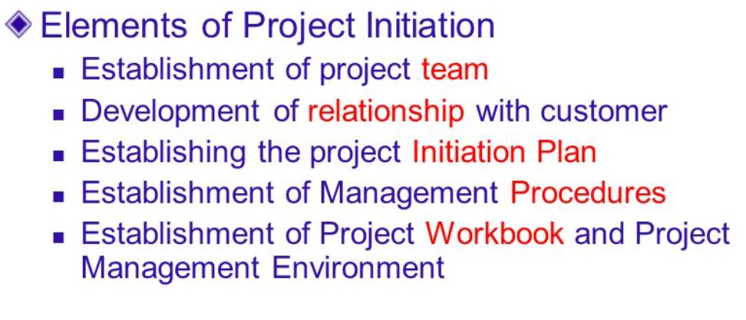

Slide 8
The process of initiating and planning IS development projects
Project initiation focuses on activities designed to assist in organizing a team to conduct project planning. During initiation, one or more analysts are assigned to work with a customer—that is, a member of the business group that requested or will be affected by the project—to establish work standards and communication procedures.
Depending upon the size, scope, and complexity of the project, some project initiation activities may be unnecessary or may be very involved. Also, many organizations have established procedures for assisting with common initiation activities.

Slide 9
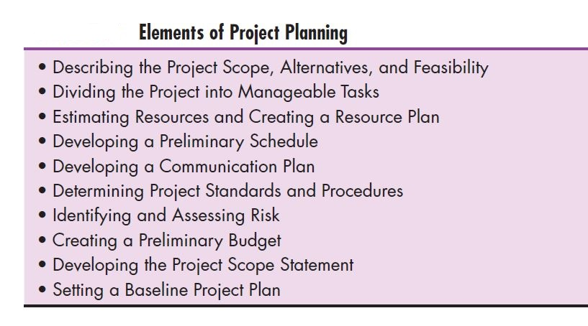

Slide 10
Project planning
Project planning is the process of defining clear, discrete activities and the work needed to complete each activity within a single project. The objective of the project planning process is the development of a Baseline Project Plan (BPP) and the Project Scope Statement (PSS) (Morris and Sember, 2008). The BPP becomes the foundation for the remainder of the development project. The PSS produced by the team clearly outlines the objectives and constraints of the project for the customer. As with the project initiation process, the size, scope, and complexity of a project will dictate the comprehensiveness of the project planning process and resulting documents. Further, numerous assumptions about resource availability and potential problems will have to be made. Analysis of these assumptions and system costs and benefits forms a business case.

Slide 11
Deliverables and outcomes
The major outcomes and deliverables from the project initiation and planning phase are :
Baseline Project Plan
Project Scope Statement (PSS).

Slide 12
Baseline Project Plan (BPP)
The Baseline Project Plan (BPP) contains all information collected and analyzed during project initiation and planning. The plan reflects the best estimate of the project’s scope, benefits, costs, risks, and resource requirements given the current understanding of the project. The BPP specifies detailed project activities for the next life cycle phase— analysis—and less detail for subsequent project phases (because these depend on the results of the analysis phase). Similarly, benefits, costs, risks, and resource requirements will become more specific and quantifiable as the project progresses. The BPP is used by the project selection committee to decide whether the project should be accepted, redirected, or canceled. If selected, the BPP becomes the foundation document for all subsequent SDLC activities; however, it is also expected to evolve (to develop gradually ) as the project evolves. That is, as new information is learned during subsequent SDLC phases, the baseline plan will be updated.

Slide 13
Project Scope Statement (PSS)
The Project Scope Statement (PSS) is a short document prepared for the customer that describes what the project will deliver and outlines all work required to complete the project. The PSS ensures that both you and your customer gain a common understanding of the project. It is also a very useful communication tool. The PSS is a very easy document to create because it typically consists of a high-level summary of the BPP information. Depending upon your relationship with your customer, the role of the PSS may vary.
At one extreme, the PSS can be used as the basis of a formal contractual agreement outlining firm deadlines, costs, and specifications. At the other extreme, the PSS can simply be used as a communication vehicle to outline the current best estimates of what the project will deliver, when it will be completed, and the resources it may consume. A contract programming or consulting firm, for example, may establish a very formal relationship with a customer and use a PSS that is extensive and formal. Alternatively, an internal development group may develop a PSS that is only one to two pages in length and is intended to inform customers rather than to set contractual obligations and deadlines.

Slide 14
Project Feasibility
All projects are feasible given unlimited resources and infinite time (Pressman, 2014). Unfortunately, most projects must be developed within tight budgetary and time constraints. This means that assessing project feasibility is a required activity for all information systems projects and is a potentially large undertaking. It requires that you, as a systems analyst, evaluate a wide range of factors. Typically, the relative
importance of these factors will vary from project to project. Most feasibility factors are represented by the following categories:
Economic
Technical
Operational
Scheduling
Legal and contractual
Political

Slide 15
Economic Feasibility
The purpose of assessing economic feasibility is to identify the financial benefits and costs associated with the development project (Laplante, 2006). Economic feasibility is often referred to as cost–benefit analysis. During project initiation and planning, it will be impossible for you to precisely define all benefits and costs related to a particular project. Yet it is important that you spend adequate time identifying and quantifying these items or it will be impossible for you to conduct an adequate economic analysis and make meaningful comparisons between rival projects. Here we will describe typical benefits and costs resulting from the development of an information system and provide several useful worksheets for recording costs and benefits. Additionally, several common techniques for making cost–benefit calculations are presented. These worksheets and techniques are used after each SDLC phase as the project is reviewed in order to decide whether to continue, redirect, or kill a project.

Slide 16
Determining Project Benefits
An information system can provide many benefits to an organization. For example, a new or renovated information system can automate monotonous jobs and reduce errors; provide innovative services to customers and suppliers; and improve organizational efficiency, speed, flexibility, and morale. In general, the benefits can be viewed as being both tangible and intangible

Slide 17
Tangible benefits
Tangible benefits refer to items that can be measured in dollars and with certainty. Examples of tangible benefits might include reduced personnel expenses, lower transaction costs, or higher profit margins. It is important to note that not all tangible benefits can be easily quantified (to measure something in amount). For example, a tangible benefit that allows a company to perform a task in 50 percent of the time may be difficult to quantify in terms of hard dollar savings.

Slide 18
Most tangible benefits will fit within the following categories:
Cost reduction and avoidance
Error reduction
Increased flexibility
Increased speed of activity
Improvement of management planning and control
Opening new markets and increasing sales opportunities

Slide 19
Intangible benefits
Intangible benefits of the system could not be quantified. Intangible benefits refer to items that cannot be easily measured in dollars or with certainty. Intangible benefits may have direct organizational benefits, such as the improvement of employee morale, or they may have broader societal implications, such as the reduction of waste creation or resource consumption. Actual benefits will vary from system to system. After determining project benefits, project costs must be identified.

Slide 20
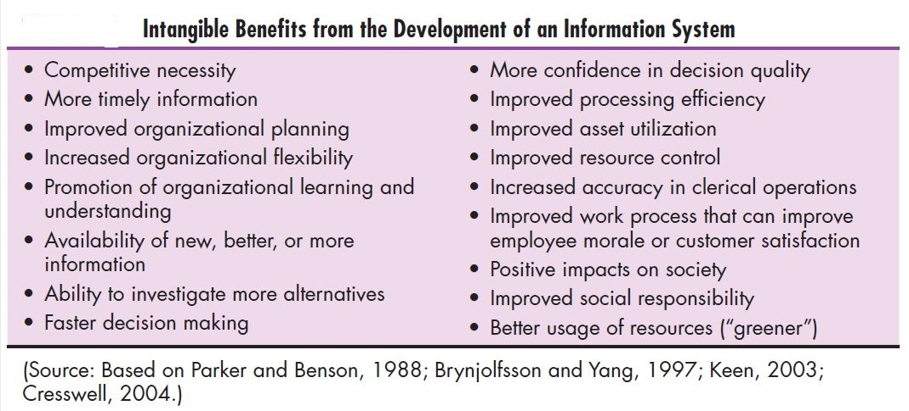

Slide 21
Determining Project Costs
Similar to benefits, an information system can have both tangible and intangible costs. Tangible costs refer to items that you can easily measure in dollars and with certainty. From an IS development perspective, tangible costs include items such as hardware costs, labor costs, and operational costs including employee training and building renovations. Alternatively, intangible costs are items that you cannot easily measure in terms of dollars or with certainty. Intangible costs can include loss of customer goodwill, employee morale, or operational inefficiency. One goal of a cost–benefit analysis is to accurately determine the total cost of ownership (TCO) for an investment (Nash, 2008). TCO is focused on understanding not only the total cost of acquisition but also all costs associated with ongoing use and maintenance of a system. Consequently, besides tangible and intangible costs, you can distinguish IS-related development costs as either one-time or recurring.

Slide 22
One-time costs refer to those associated with project initiation and development and the start-up of the system. These costs typically encompass activities such as systems development, new hardware and software purchases, user training, site preparation, and data or system conversion. When conducting an economic cost–benefit analysis, a worksheet should be created for capturing these expenses. For very large projects, one-time costs may be staged over one or more years. In these cases, a separate onetime cost worksheet should be created for each year. This separation will make it easier to perform present value calculations (described later). Recurring costs refer to those costs resulting from the ongoing evolution and use of the system. Examples of these costs typically include the following:
•Application software maintenance
•Incremental data storage expenses
•Incremental communications
•New software and hardware leases
•Supplies and other expenses (e.g., paper, forms, data center personnel)

Slide 23
One-time costs refer to those associated with project initiation and development and the start-up of the system. These costs typically encompass activities such as systems development, new hardware and software purchases, user training, site preparation, and data or system conversion. When conducting an economic cost–benefit analysis, a worksheet should be created for capturing these expenses. For very large projects, one-time costs may be staged over one or more years. In these cases, a separate onetime cost worksheet should be created for each year. This separation will make it easier to perform present value calculations.

Slide 24
Recurring costs refer to those costs resulting from the ongoing evolution and use of the system. Examples of these costs typically include the following:
Application software maintenance
Incremental data storage expenses
Incremental communications
New software and hardware leases
Supplies and other expenses (e.g., paper, forms, data center personnel)
Both one-time and recurring costs can consist of items that are fixed or variable in nature. Fixed costs are costs that are billed or incurred at a regular interval and usually at a fixed rate (a facility lease payment). Variable costs are items that vary in relation to usage (long-distance phone charges).

Slide 25
The Time Value of Money
Most techniques used to determine economic feasibility encompass the concept of the time value of money (TVM), which reflects the notion that money available today is worth more than the same amount tomorrow. As previously discussed, the development of an information system has both one-time and recurring costs. Furthermore, benefits from systems development will likely occur sometime in the future. Because many projects may be competing for the same investment dollars and may have different useful life expectancies, all costs and benefits must be viewed in relation to their present value when comparing investment options.

Slide 26
Technical Feasibility
The purpose of assessing technical feasibility is to gain an understanding of the organization’s ability to construct the proposed system. This analysis should include an assessment of the development group’s understanding of the possible target hardware, software, and operating environments to be used, as well as system size, complexity, and the group’s experience with similar systems. It is important to note that all projects have risk and that risk is not necessarily something to avoid. Yet it is also true that, because organizations typically expect a greater return on their investment for riskier projects, understanding the sources and types of technical risks proves to be a valuable tool when you assess a project. Also, risks need to be managed in order to be minimized; you should, therefore, identify potential risks as early as possible in a project.

Slide 27
The potential consequences of not assessing and managing risks can include the following:
Failure to attain expected benefits from the project
Inaccurate project cost estimates
Inaccurate project duration estimates
Failure to achieve adequate system performance levels
Failure to adequately integrate the new system with existing hardware, software, or organizational procedures.

Slide 28
The amount of technical risk associated with a given project is contingent( or depends) on four primary factors: project size, project structure, the development group’s experience with the application and technology area, and the user group’s experience with systems development projects and the application area.
Large projects are riskier than small projects.
A system in which the requirements are easily obtained and highly structured will be less risky than one in which requirements are messy, ill-structured, ill-defined, or subject to the judgment of an individual
The development of a system employing commonly used or standard technology will be less risky than one employing novel (a long printed story about imaginary characters and events ) or nonstandard technology.
A project is less risky when the user group is familiar with the systems development process and application area than if the user group is unfamiliar with them.

Slide 29
Operational feasibility
Its purpose is to gain an understanding of the degree to which the proposed system will likely solve the business problems or take advantage of the opportunities outlined in the System Service Request or project identification study. For a project motivated from information systems planning, operational feasibility includes justifying the project on the basis of being consistent with or necessary for accomplishing the information systems plan. Your assessment of operational feasibility should include an analysis of how the proposed system will affect organizational structures and procedures. Systems that have substantial and widespread impact on an organization’s structure or procedures are typically riskier projects to undertake. Thus, it is important for you to have a clear understanding of how an information system will fit into the current day-to-day operations of the organization.

Slide 30
Schedule Feasibility
Another feasibility concern relates to project duration is assessing schedule feasibility. The purpose of assessing schedule feasibility is for you, as a systems analyst, to gain an understanding of all potential time frames and completion date schedules can be met and that meeting these dates will be sufficient for dealing with the needs of the organization. Further, detailed activities may only be feasible if resources are available when called for in the schedule. For example, the schedule should not call for system testing during rushed business periods or for key project meetings during annual vacation or holiday periods. The schedule of activities produced during project initiation and planning will be very precise and detailed for the analysis phase. The estimated activities and associated times for activities after the analysis phase are typically not as detailed (e.g., it will take two weeks to program the payroll report module) as the life-cycle-phase level (e.g., it will take six weeks for physical design, four months for programming, and so on).

Slide 31
This means that assessing schedule feasibility during project initiation and planning is more of a “rough-cut” analysis of whether the system can be completed within the constraints of the business opportunity or the desires of the users.
While assessing schedule feasibility you should also evaluate scheduling trade-offs. For example, factors such as project team size, availability of key personnel, subcontracting or outsourcing activities, and changes in development environments may all be considered as having a possible impact on the eventual schedule. As with all forms of feasibility, schedule feasibility will be reassessed after each phase when you can specify with greater certainty the details of each step for the next phase.

Slide 32
Legal and Contractual Feasibility
A third concern relates to assessing legal and contractual feasibility issues. In this area, you need to gain an understanding of any potential legal ramifications (the possible results of an action) due to the construction of the system. Possible considerations might include copyright or nondisclosure infringements (an action that breaks a rule, law, etc ), labor laws, antitrust legislation (which might limit the creation of systems to share data with other organizations), foreign trade regulations (e.g., some countries limit access to employee data by foreign corporations), and financial reporting standards, as well as current or pending contractual obligations. Contractual obligations may involve ownership of software used in joint ventures, license agreements for use of hardware or software, nondisclosure agreements with partners, or elements of a labor agreement (e.g., a union agreement may preclude certain compensation or work-monitoring capabilities a user may want in a system).

Slide 33
Political Feasibility
A final feasibility concern focuses on assessing political feasibility in which you attempt to gain an understanding of how key stakeholders within the organization view the proposed system. Because information system may affect the distribution of information within the organization, and thus the distribution of power, the construction of an information system can have political ramifications. Those stakeholders not supporting the project may take steps to block, disrupt, or change the intended focus of the project.

